Slide 1
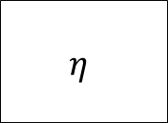
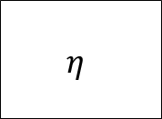
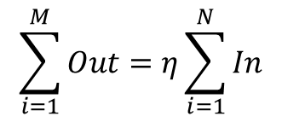
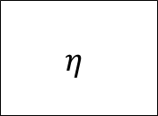
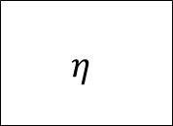
Single input
Single output
$$η$$
In₁
Out₁
Single input
Multi-output
$$η$$
Out₁
In₁
…
Out_{M}
$$\sum_{i=1}^{M}{Out}=η\sum_{i=1}^{N}{In}$$
Multi-input
Single output
In₁
$$η$$
…
Out₁
In_{N}
Multi-input
Multi-output
In₁
$$η$$
Out₁
…
…
In_{N}
Out_{M}

Slide 2
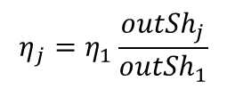
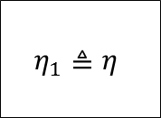
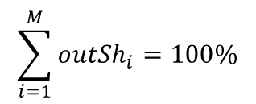
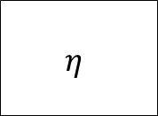
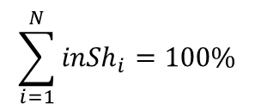
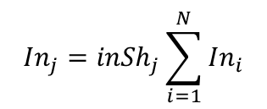

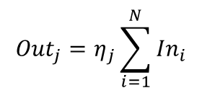

$$\sum_{i=1}^{N}{{inSh}_{i}}=100\%$$
inSh₁
$$η$$
Fixed input shares (inSh)
In₁
$${In}_{j}={inSh}_{j}\sum_{i=1}^{N}{{In}_{i}}$$
…
inSh_{N}
In_{N}
$$∀j∈set of inputs$$
$$\sum_{i=1}^{M}{{outSh}_{i}}=100\%$$
$$η_{1}≜η$$
outSh₁
Fixed output shares (outSh)
Out₁
$$η_{j}=η_{1}\frac{{outSh}_{j}}{{outSh}_{1}}$$
…
outSh_{M}
Out_{M}
$${Out}_{j}=η_{j}\sum_{i=1}^{N}{{In}_{i}}$$
$$∀j∈set of outputs$$

Slide 3

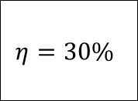


Example: CHP plant (single input, multi-output, fixed output share)
outSh₁=35%
$$η_{1}≜η=30\%$$
$$η=30\%$$
Electricity
Gas
$$η_{2}=η_{1}\frac{{outSh}_{2}}{{outSh}_{1}}=30\%\frac{65\%}{35\%}=56\%$$
outSh₂=65%
Heat
$$Heat to power ratio=\frac{{outSh}_{2}}{{outSh}_{1}}=1.86$$

